Slide 1

Where’s My Data, Dude?
By: Craig, Ricky, & Paul

Slide 2
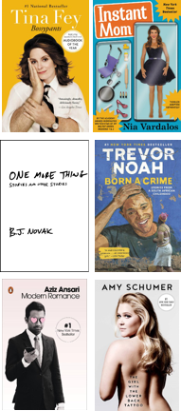
Celebrity Books
Social Media & Point-of-Sale Analysis of
Bossypants
Instant Mom
Born A Crime
Modern Romance
The Girl with The Lower Back Tattoo

Slide 3

Business Problem
Where’s
My Data,
Dude?!
Visualization
Technologies
Conclusion

Slide 4
Publishing Segments have varying ranges of digital and print demand.

Slide 5
Unit sales by week as a % of total may appear common

Slide 6
Total Initial 20 Weeks POS
(in units)

Slide 7

Media Celebrity Reach Vs Demand
The Story
Social Volume Vs POS Results
Social sentiment Vs POS Results
Book reviews Vs Sentiment
Social lag Vs POS Results

Slide 8

Does social media celebrity ‘reach’ correlate to volume demand?

Slide 9
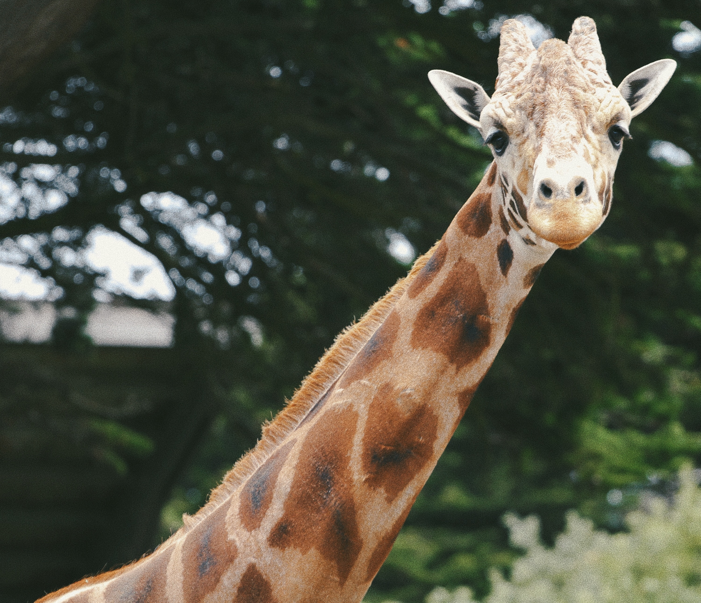
Nawh

Slide 10

Ω
Does the volume of social media activity influence POS results?

Slide 11
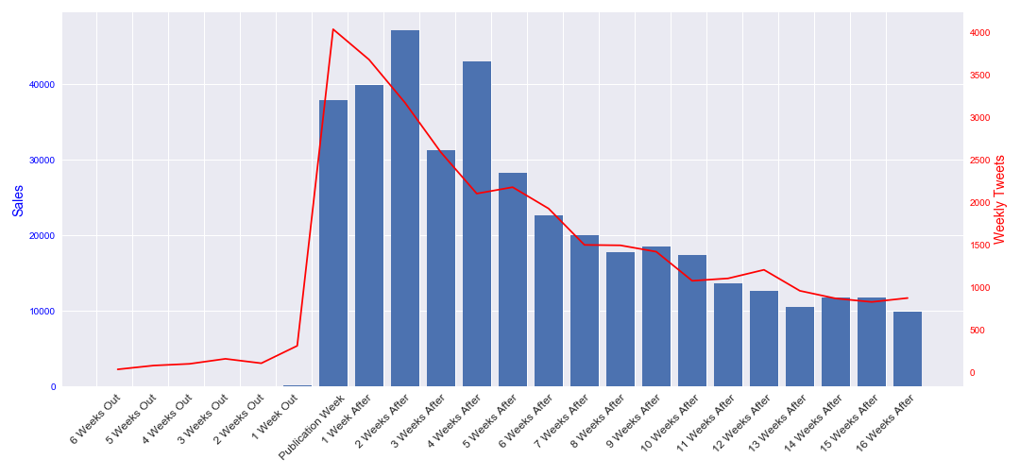
R Square= .89
Bossypants

Slide 12
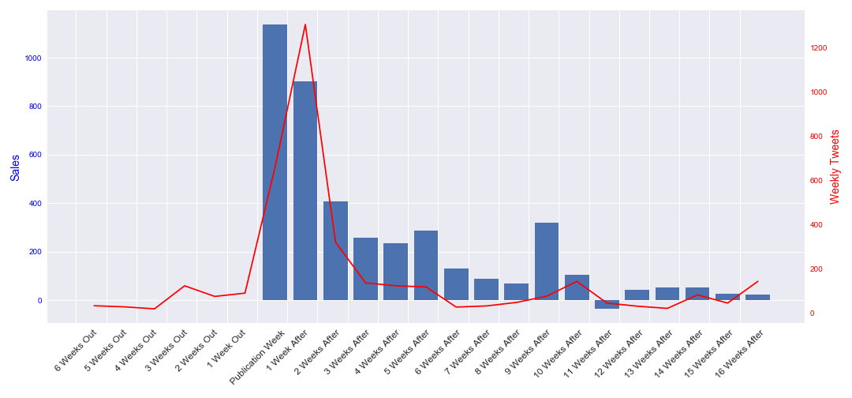
R Square= .72
Instant Mom

Slide 13
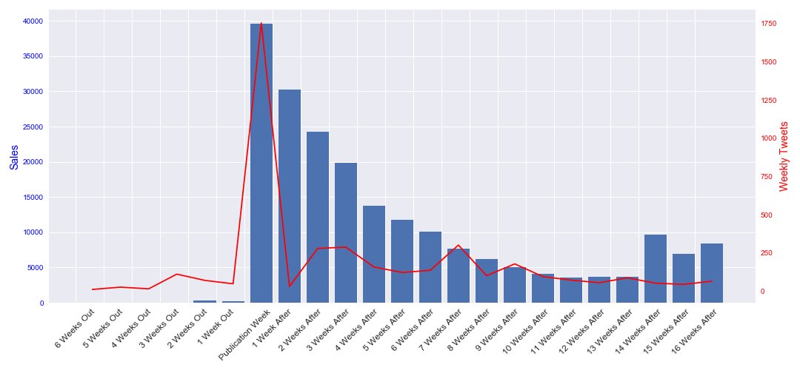
R Square= .49
Girl With The Lower Back Tattoo

Slide 14
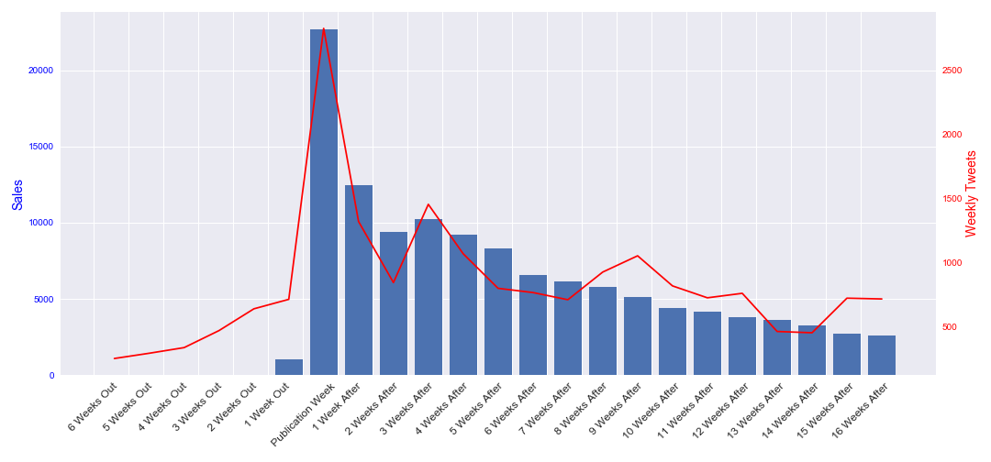
R Square= .85
Modern Romance

Slide 15
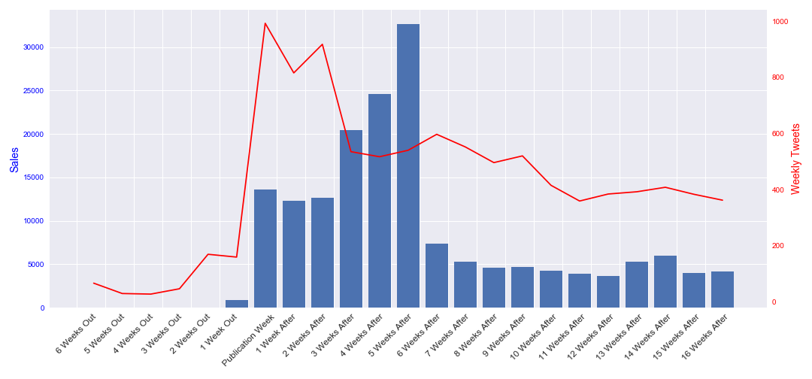
R Square= .35
Born a Crime

Slide 16
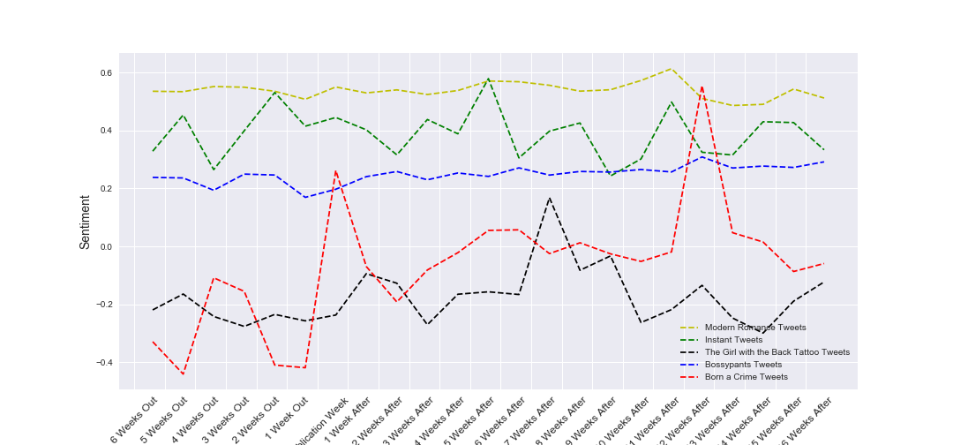
Does the sentiment of social media influence POS results?

Slide 17
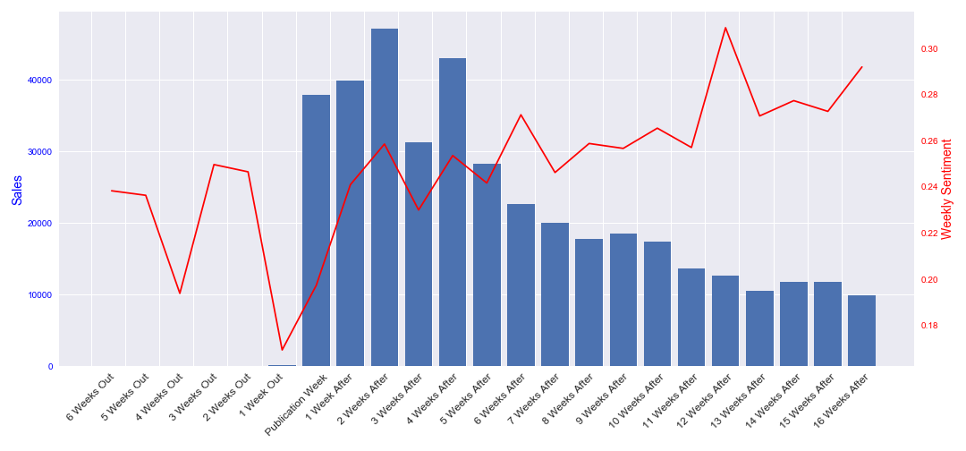
Bossypants

Slide 18
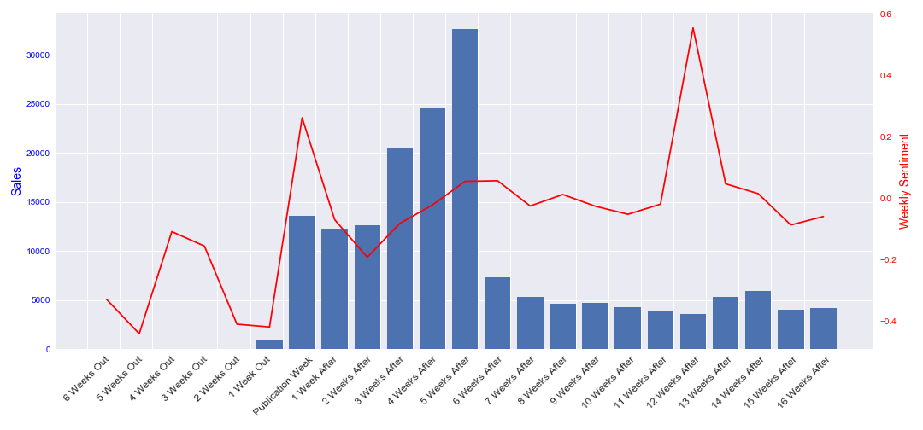
Born a Crime

Slide 19
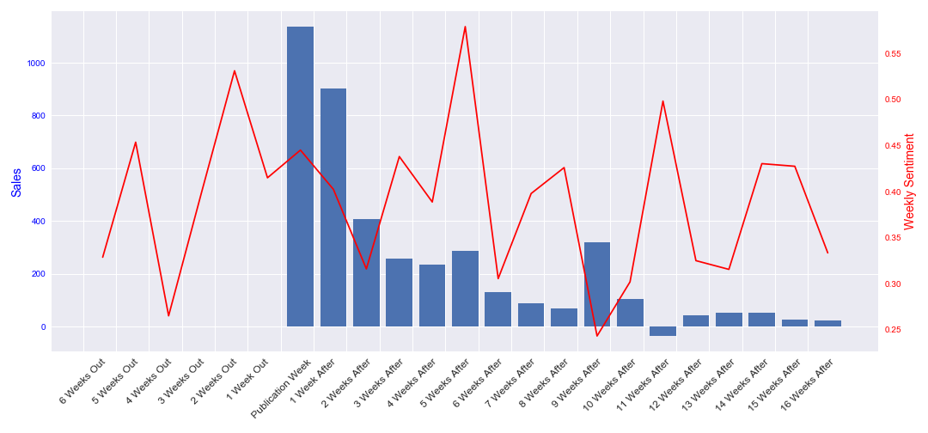
Instant Mom

Slide 20

Girl With The Lower Back Tattoo

Slide 21
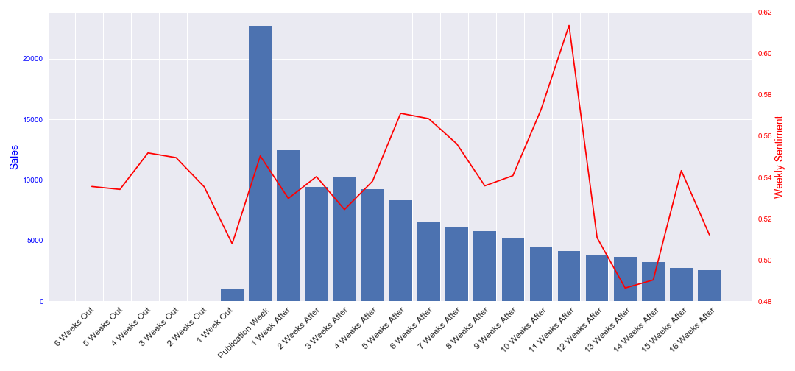
Modern Romance

Slide 22


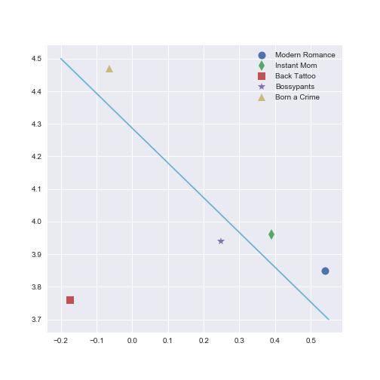
Do book reviews track with social sentiment?

Slide 23

Visible lag period between twitter activity and POS activity?

Slide 24
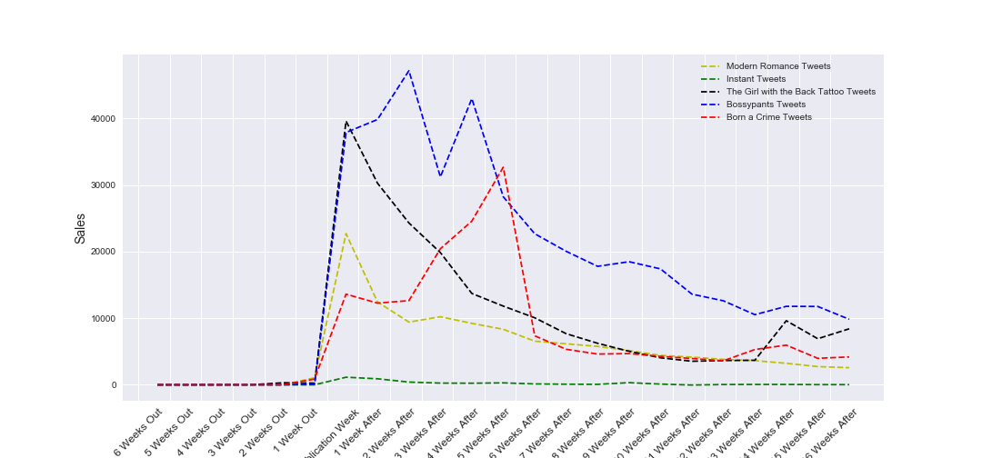
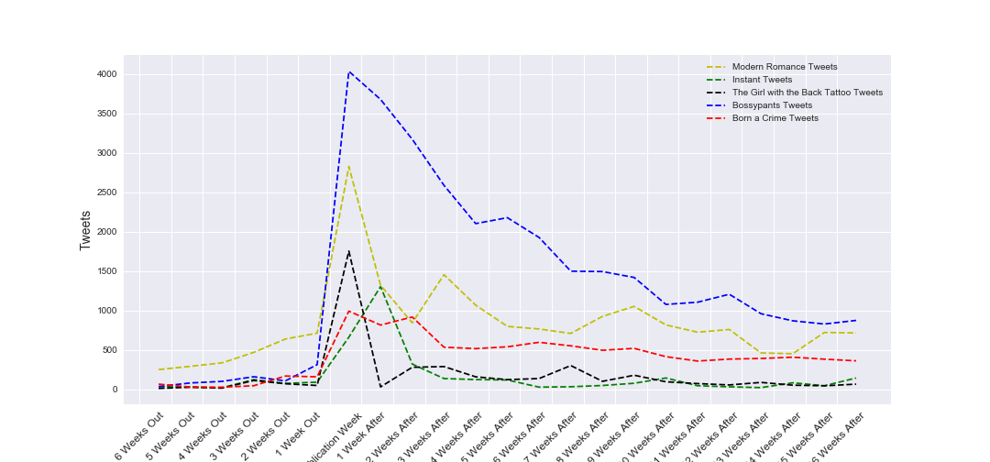
Sales
Tweets

Slide 25

Technologies
Nielsen BookScan Point-of-Sale Data
Twitter Advanced Search
Good Reads API
Python 2 & 3
Pandas
Vader Sentiment Analysis
Excel
VBA

Slide 26
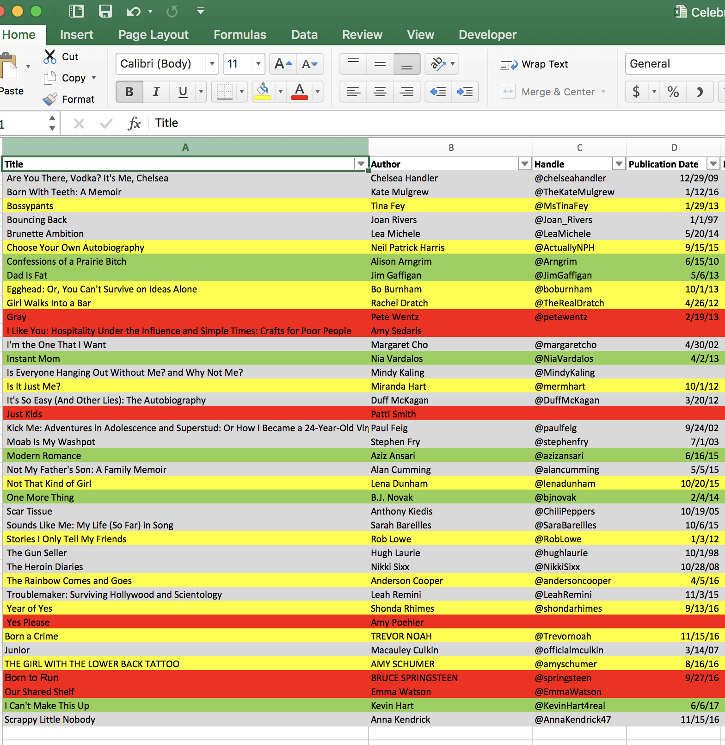
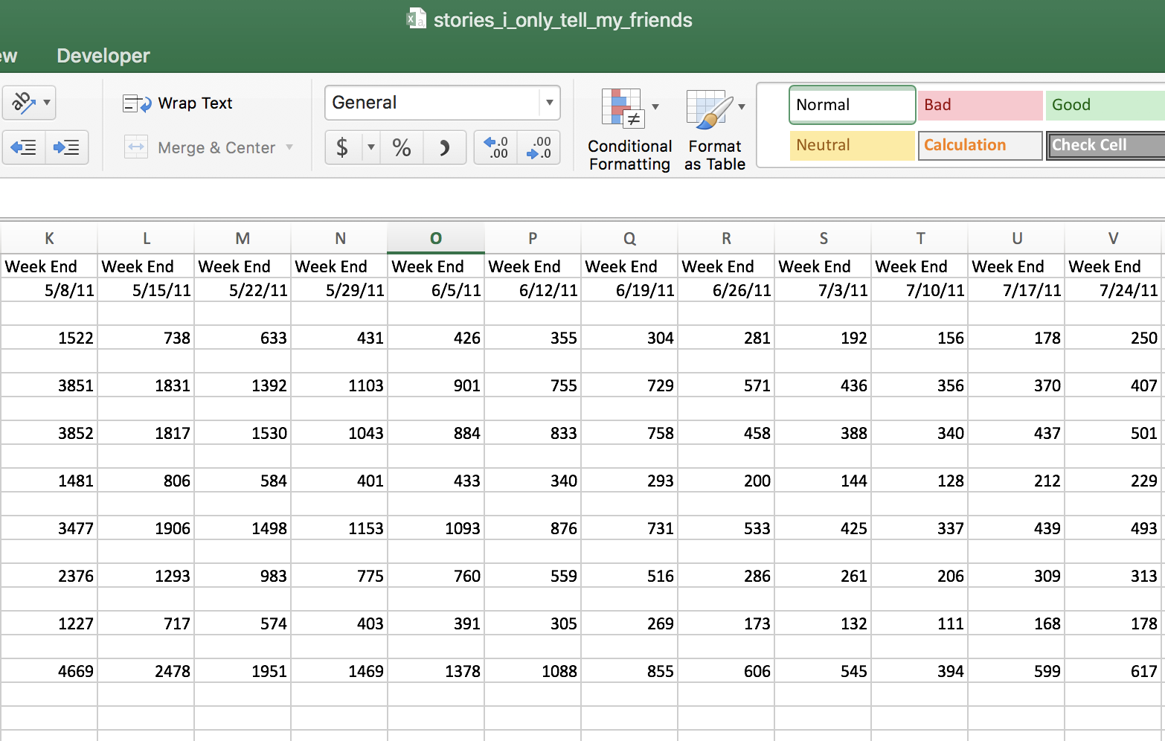
Where Do We Start?

Slide 27
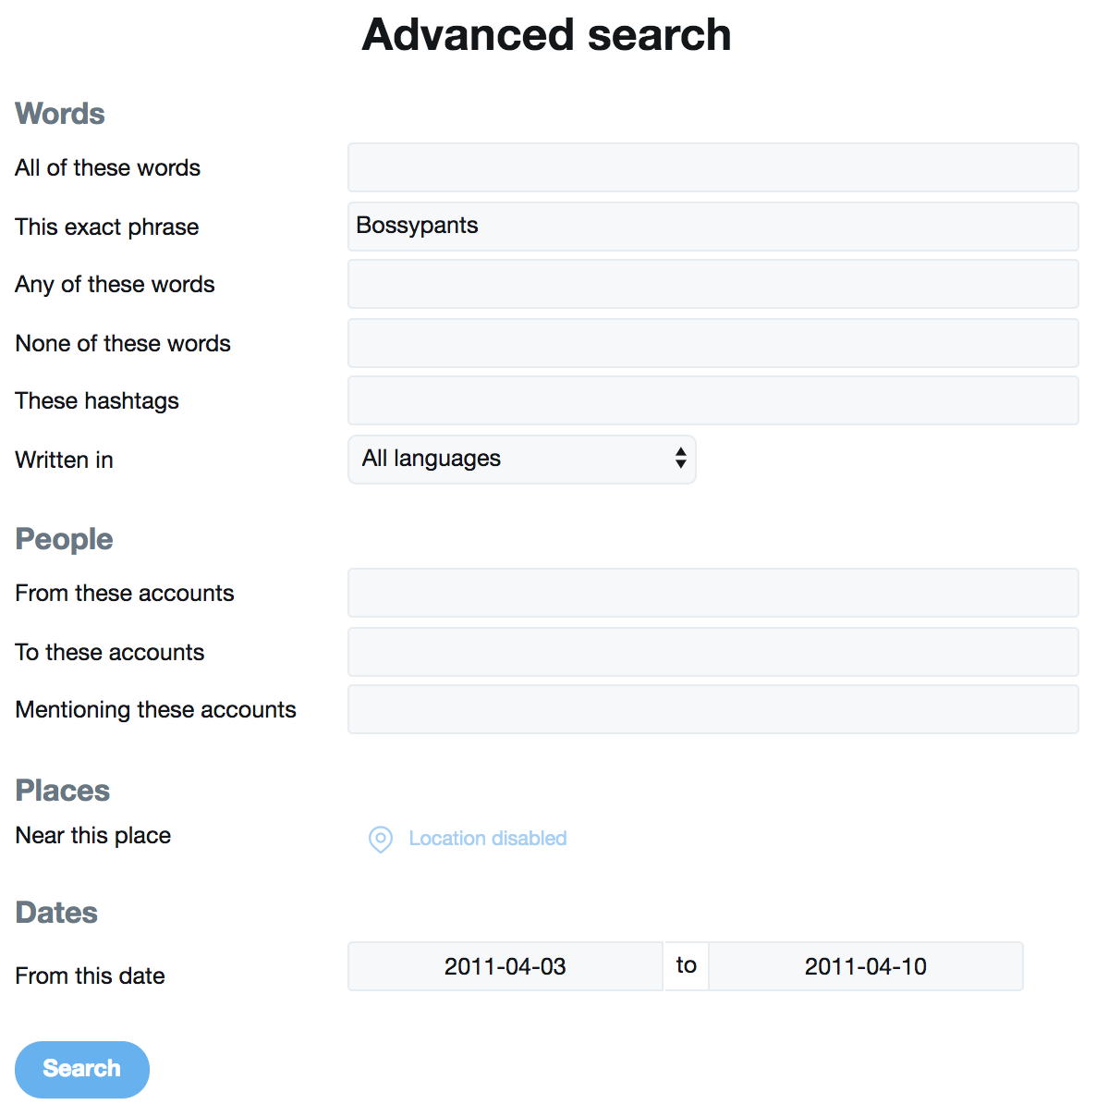
Twitter Advanced Search
Book Title
Range of Dates

Slide 28
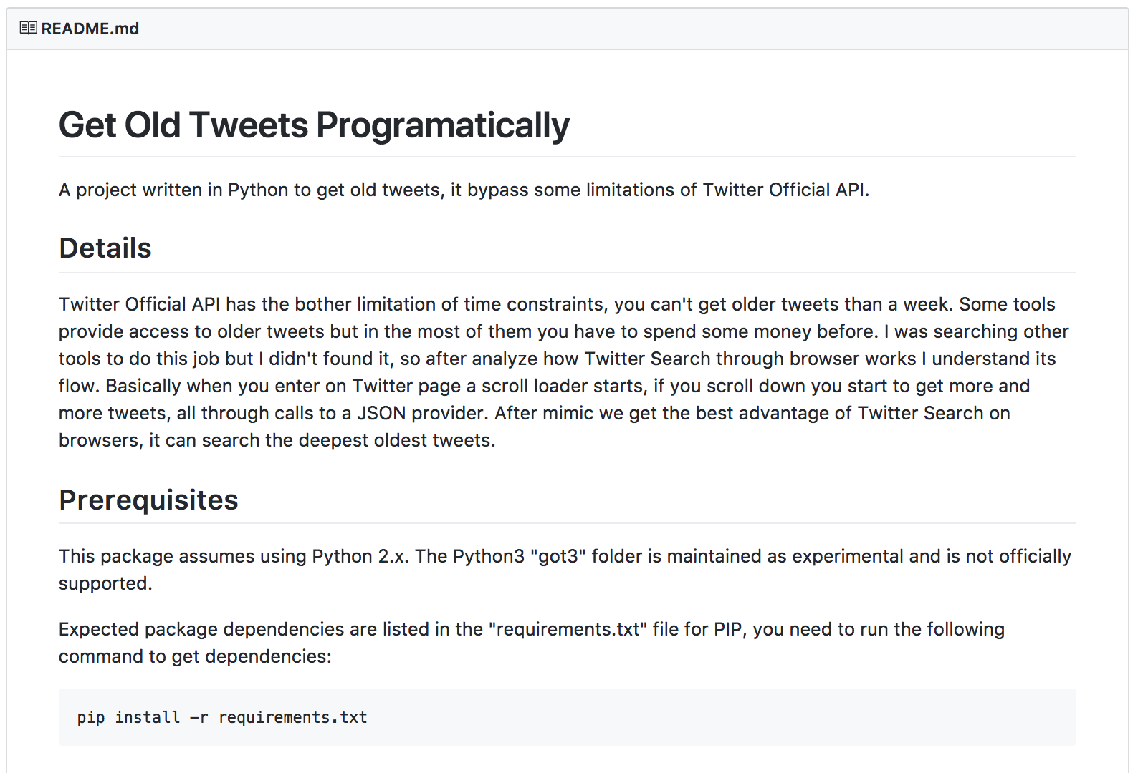

Slide 29
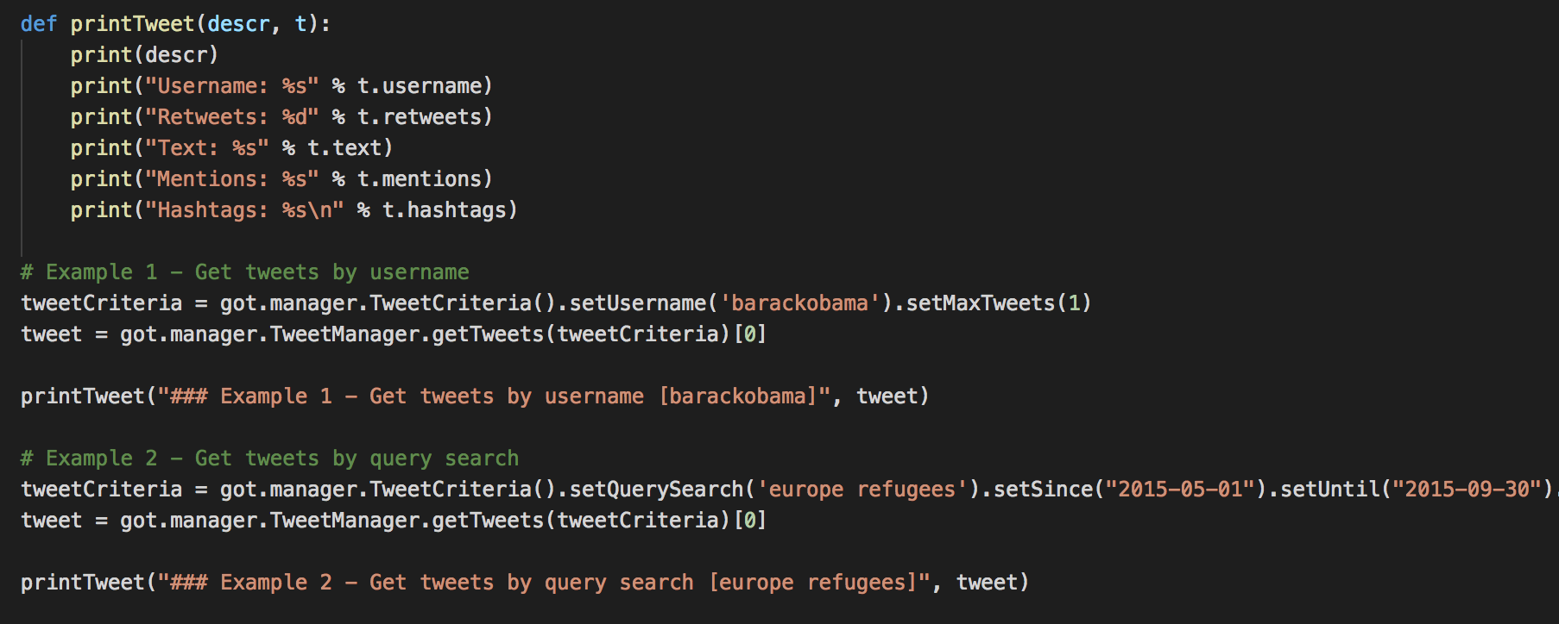
GetOldTweets
Anddddd bingo… almost.

Slide 30
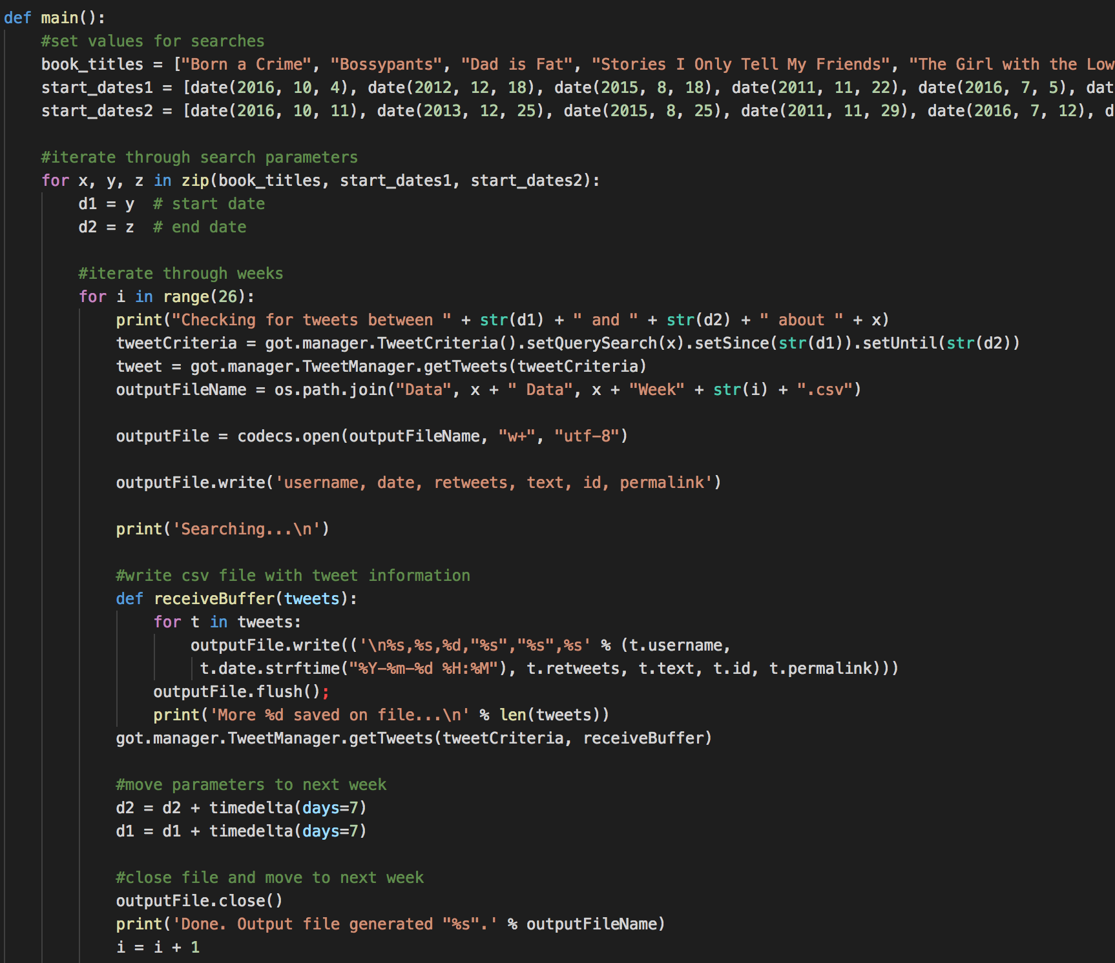
Search Books Loop
Lists of book search terms and start dates
For loop using a zip to iterate simultaneously
Print checks, use search term and loop counter for file name
Move time parameters using timedelta

Slide 31


Slide 32
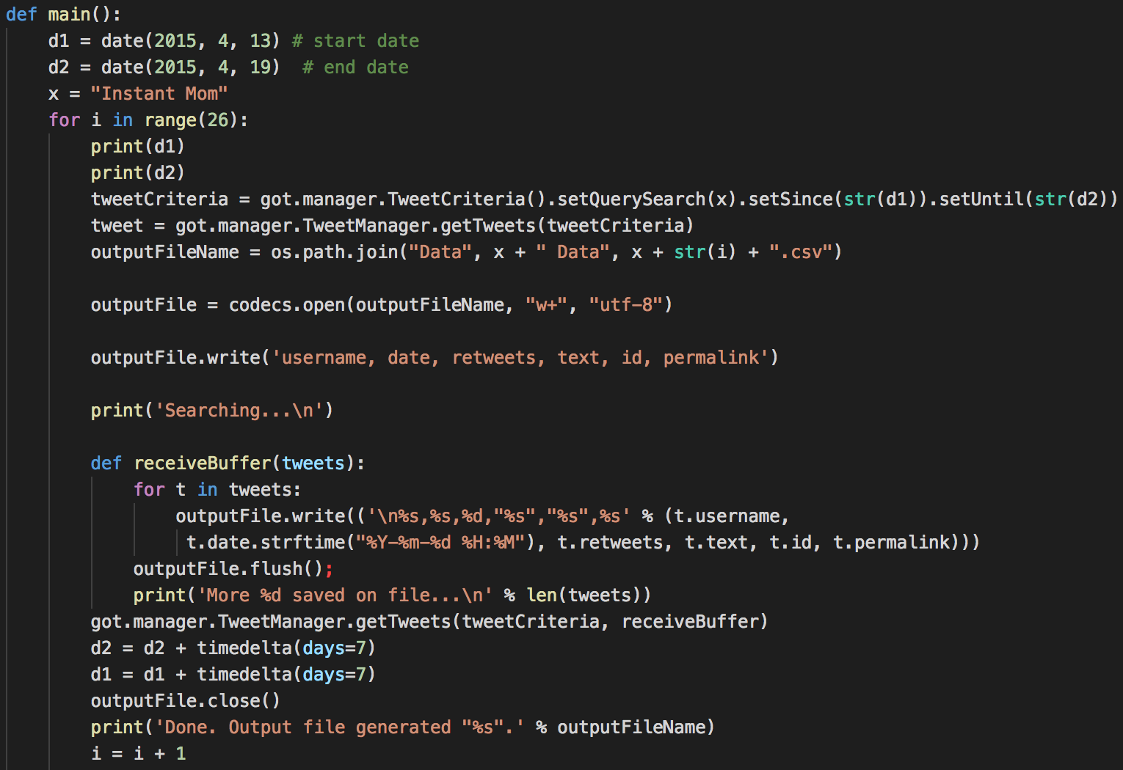
Search Books Redux

Slide 33
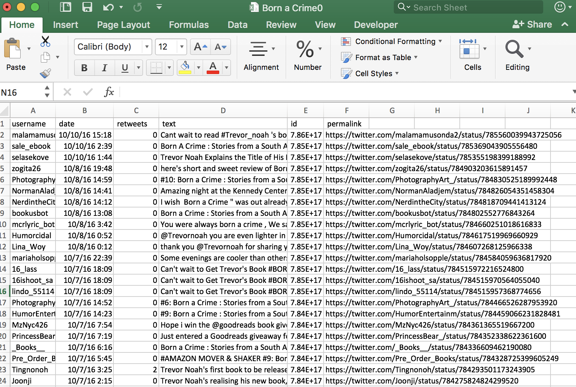
Beautiful, beautiful tweets, but…

Slide 34
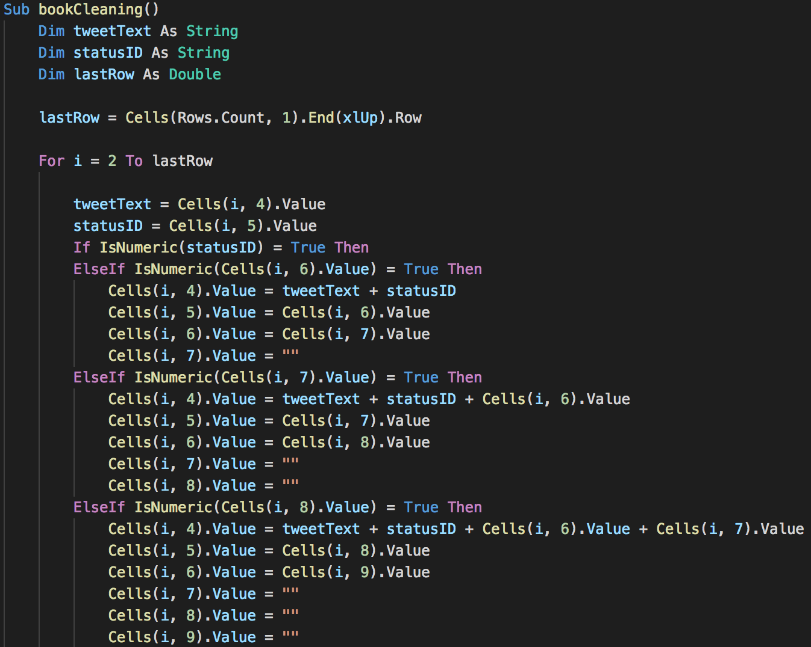
Really Fun VBA Script
Set expected value for tweet text
Set expected value for tweet status ID
Use IsNumeric() to isolate status ID
Use If statements to move columns

Slide 35
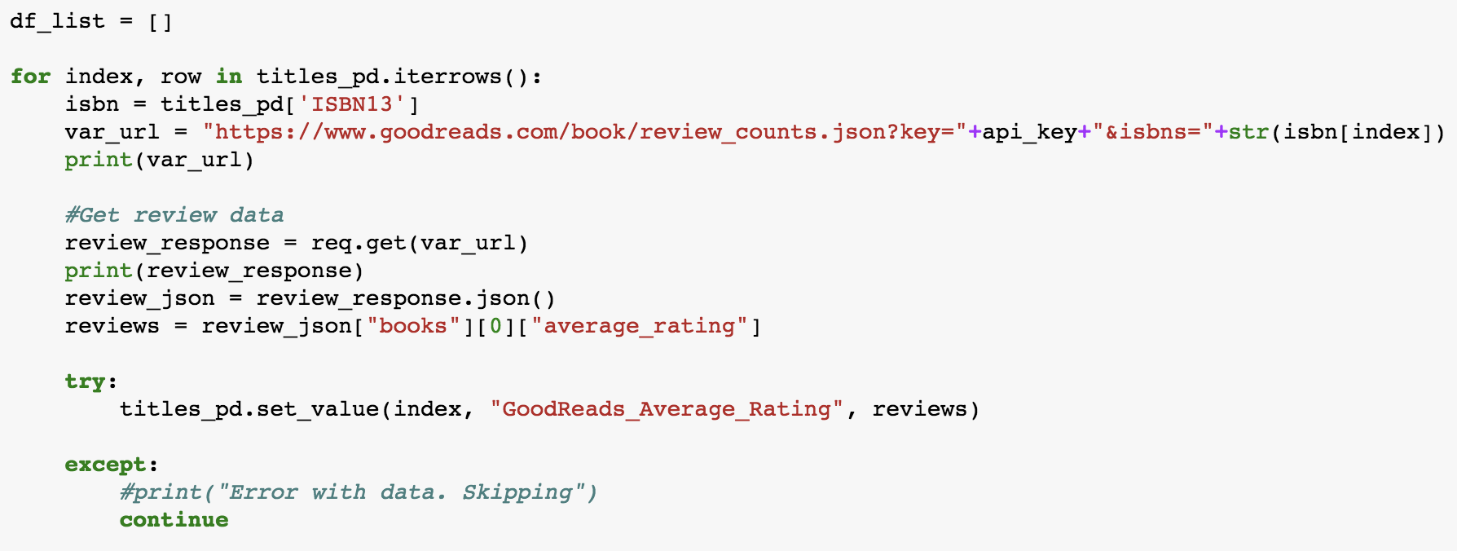
GoodReads API Requests
XML?
Use ISBN number to track down correct book and version.

Slide 36

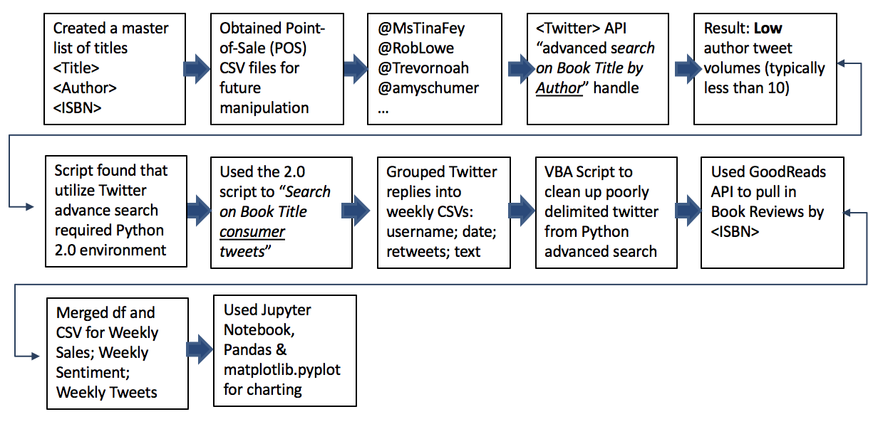
Workflow

